Slide 1
Сайт приемной комиссии АО «МУИТ»
Team members: курсанты ВИИРЭиС
к-нт Ермағамбет М.С.
к-нт Олжабаев Б.М.

Slide 2
Сайт приемной комиссии АО «МУИТ»
The site is intended to familiarize future students and receive online consultations, as well as for students who want to study under the student exchange program to receive various information. To help learners remotely.

Slide 3
The relevance of the site is to familiarize future students and receive online consultations, as well as for students who want to study under the student exchange program to receive various information. To help learners remotely.

Slide 4
Responsibility of team members
Olzhabayev B.M.:
- Main page
- Registration page
- Contact
Ermagambet М.S.:
- Admin page
- Distance learning
- For pupils

Slide 5
Project features
This site allows you to follow the latest news happening at the International University of Information Technology and provides thorough information to applicants. And also there is an initial introduction for various types of training

Slide 6
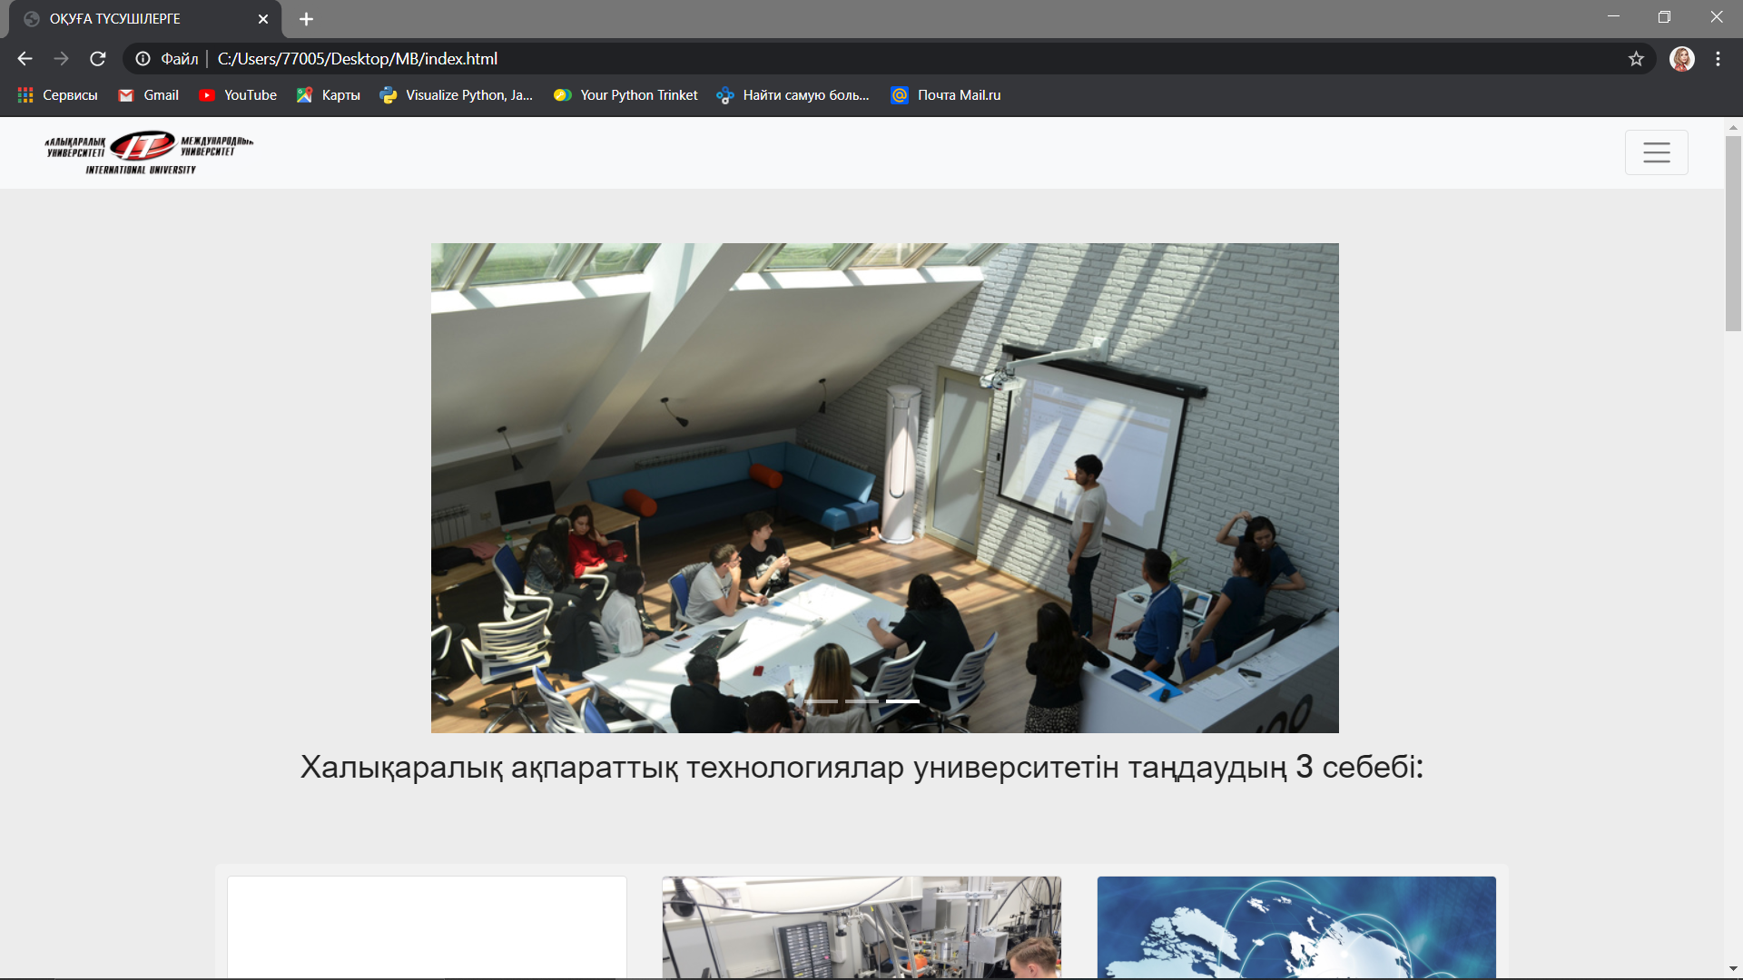
Main page

Slide 7
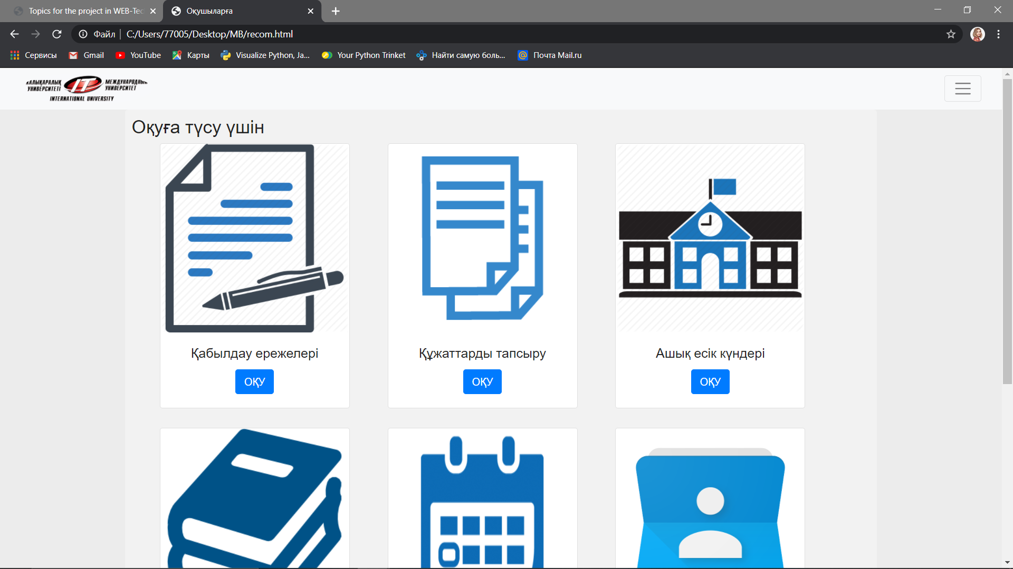
For pupils

Slide 8
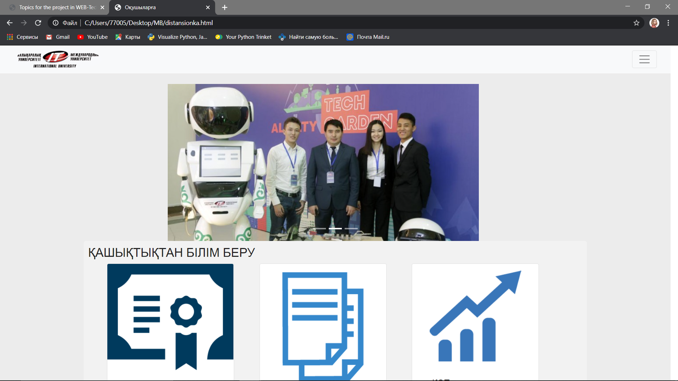
Distance learning

Slide 9
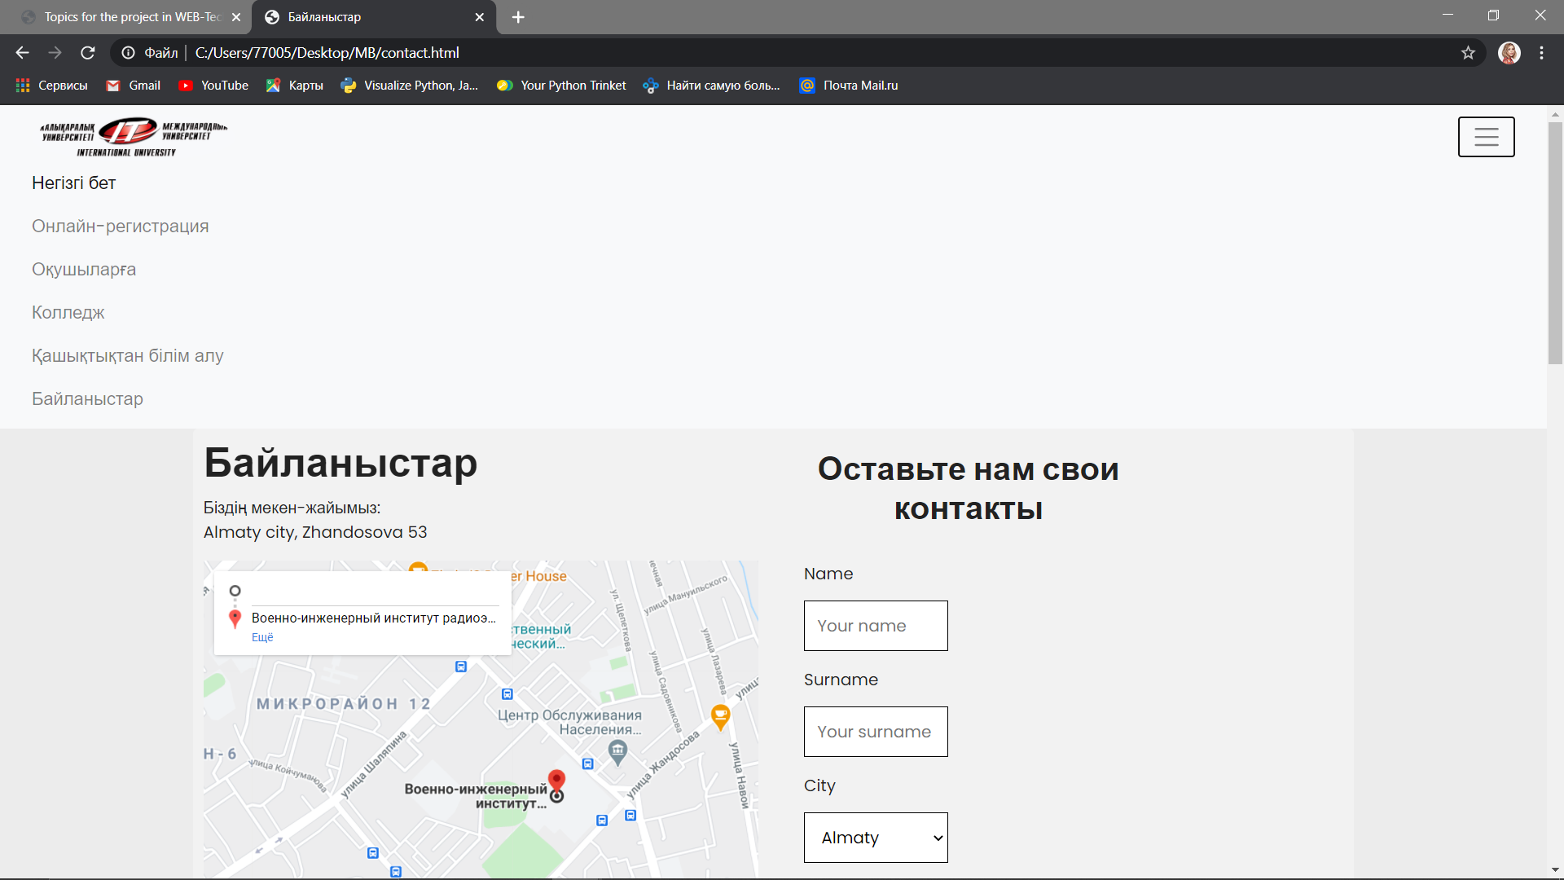
Contacts

